Slide 1
Self Navigated Hex Copter
Lawrence Ferretti

Slide 2
The Project
The goal of this project is to create implement and design a live camera system using raspberry pi and a Hex copter.

Slide 3
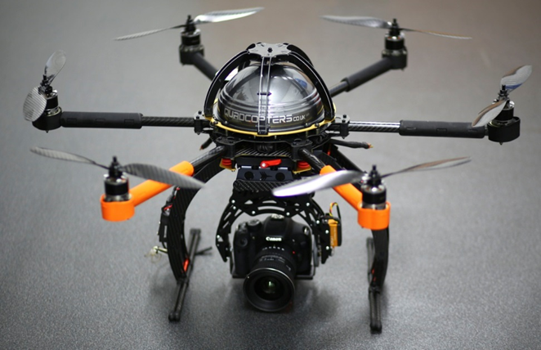
What is a Hex Copter ?
Hex copter is a multi rotor copter exactly 6 rotors and is considered a UAV. (unmanned aerial vehicles)

Slide 4
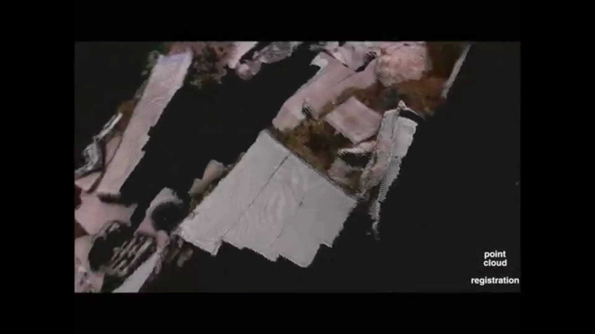
Applications
Drones are used in
Multiple applications for example this Drone is used to create 3D mapping of the ground below.

Slide 5
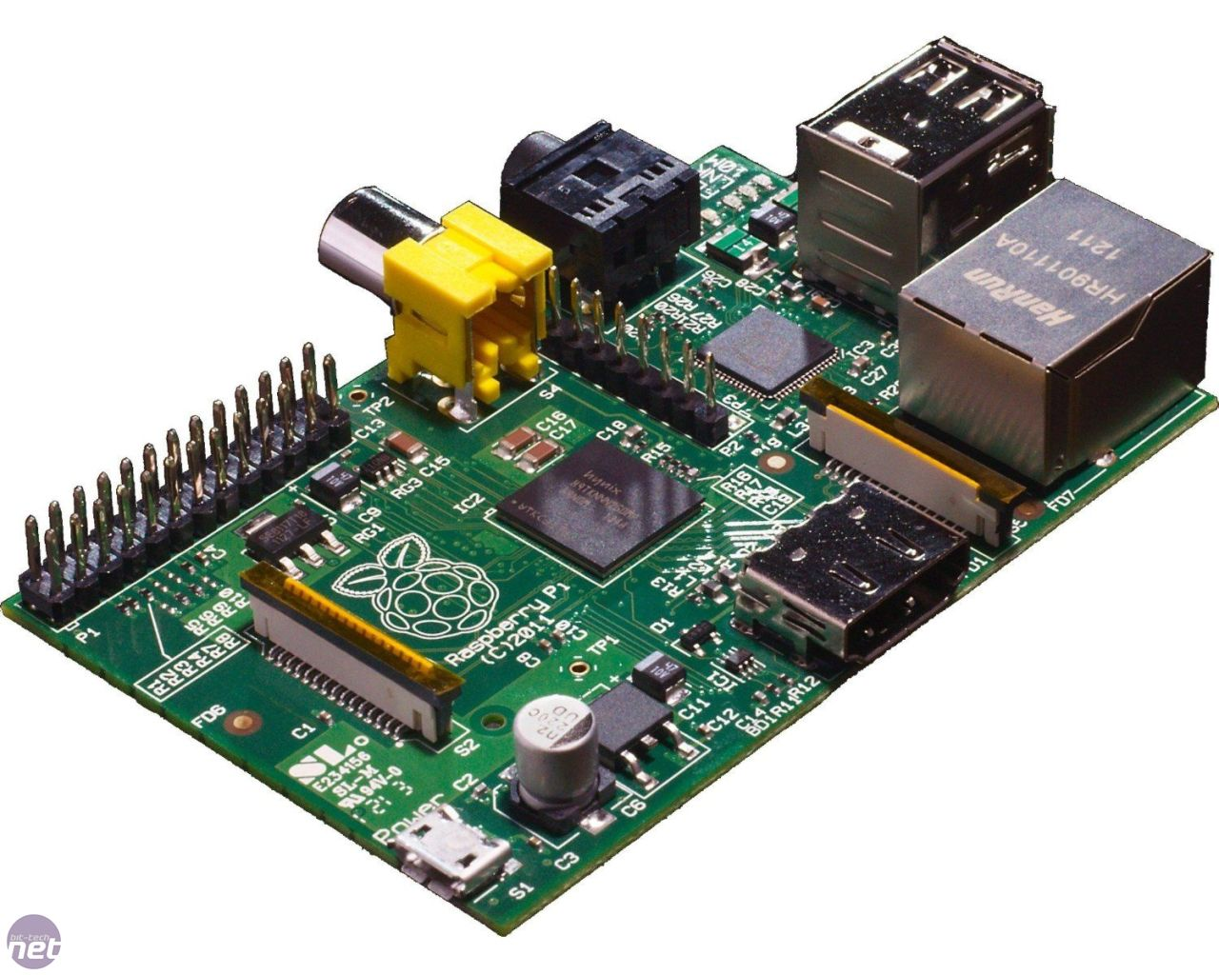
What is Raspberry PI?
Raspberry pi is a Linux base SOC. This System on chip is powered by an ARM 1176JZ Processor.
It has the capability to support
Multiple Linux Operating systems
And is used in a verity of projecs.

Slide 6
Installations
First step is to Download the OS to the raspberry pi SD card.
For this Project Raspian OS was used.
After the installation and basic set up the following applications were installed (Sudo apt-get install)
- Motion
SSH
-Nginx
- Open CV
Github Cores.
Once the applications were installed each needed to be configured.

Slide 7
Configuring motion
Motion is a Webcam camera stream using the USB Camera.
To configure this the following was changed.
Daemon = on;
Webcam_localhost = on;
Webcam_port = 8088;
Control_port 8089;

Slide 8
Configure Github
The first step is to create an account. Github.com/N02262410
Generate SSH keys this will allow you to push files to the Repository.
Once you SSH key has been generated then using the Github (Git push command)
You can commit your files to the Repository,

Slide 9
Camera and Raspberry PI Assembly
The Following system is used to control and run the Raspberry Pi and camera for the copter.
1) Logitech Quick cam
2) Wireless dongle
3) Raspberry pi
4) 10000 Mah Battery pack
5) Verizon Wireless 4G LTE Mifi Device

Slide 10
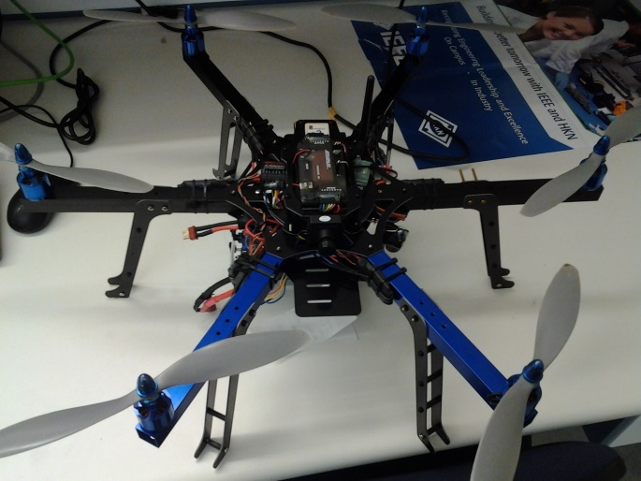
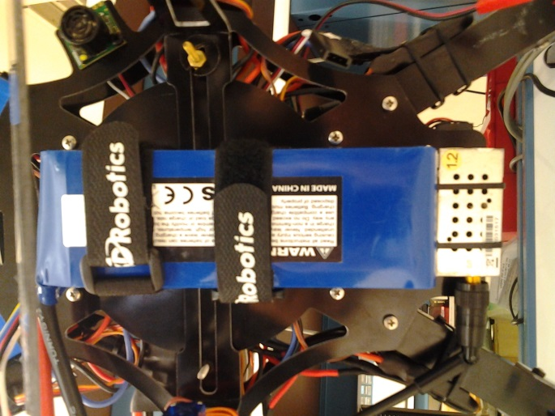
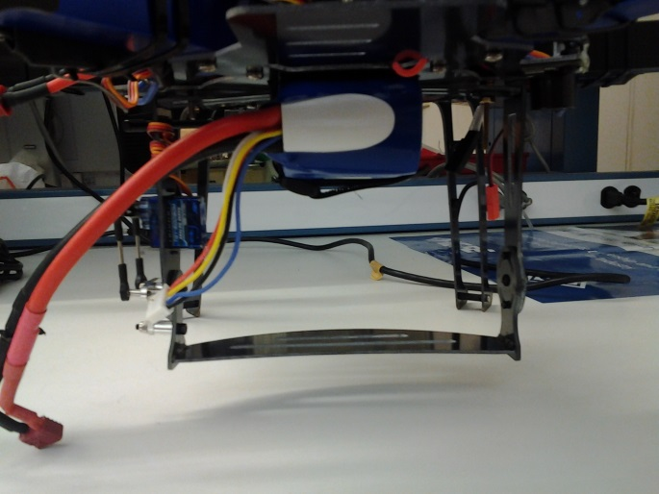
Copter Assembly.
The Copter assembly consists of 3 levels, The motors and propellers, battery holder and bottom mounting brace.

Slide 11
Copter Specifics
Arducopter Model: Hexa C Maximum height: 11,000 feet Max weight capacity: 4lbs Processor: ARM:2.5
Battery: 5000 Mah

Slide 12
Testing

Slide 13
Creating Flight paths
To create flight paths you need to select different GPS waypoints in a specific order and give the copter commands to do at each way point. Once you have selected the waypoints you will have a flight plan that looks like this.

Slide 14
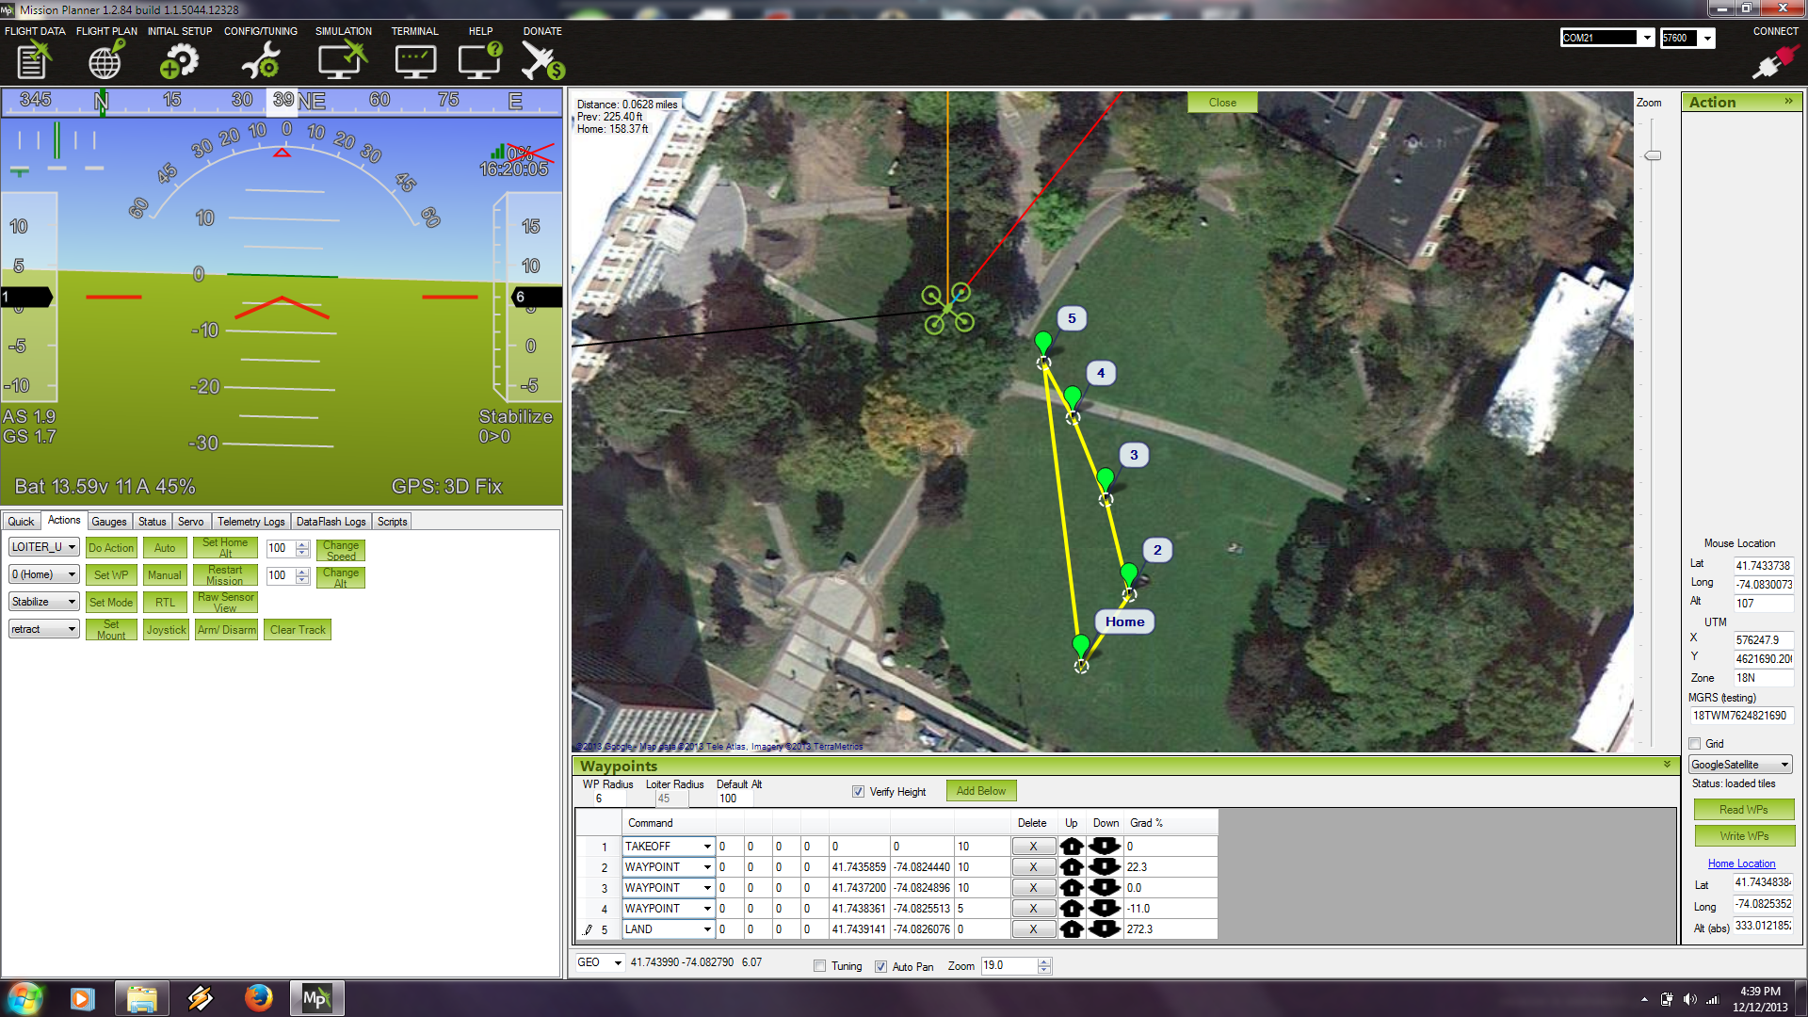

Slide 15
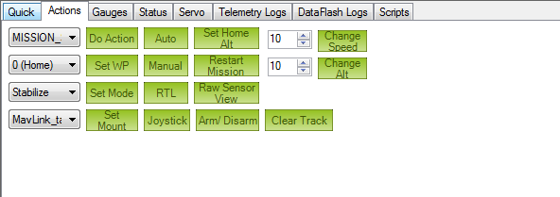
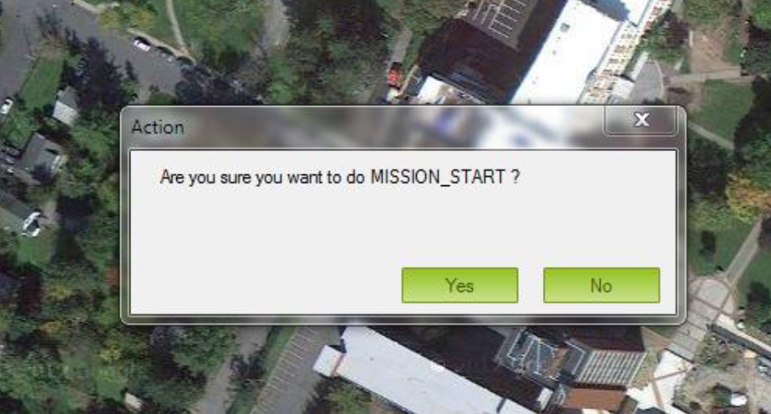
Starting the mission
To Start the mission in the flight data menu and selecting the action tab
To “DO Action” this will then prompt you to start the mission.

Slide 16
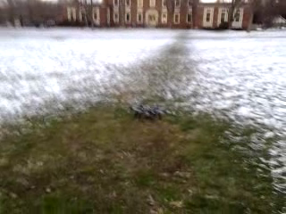
The Take off.

Slide 17
The Flight Path Taken

Slide 18
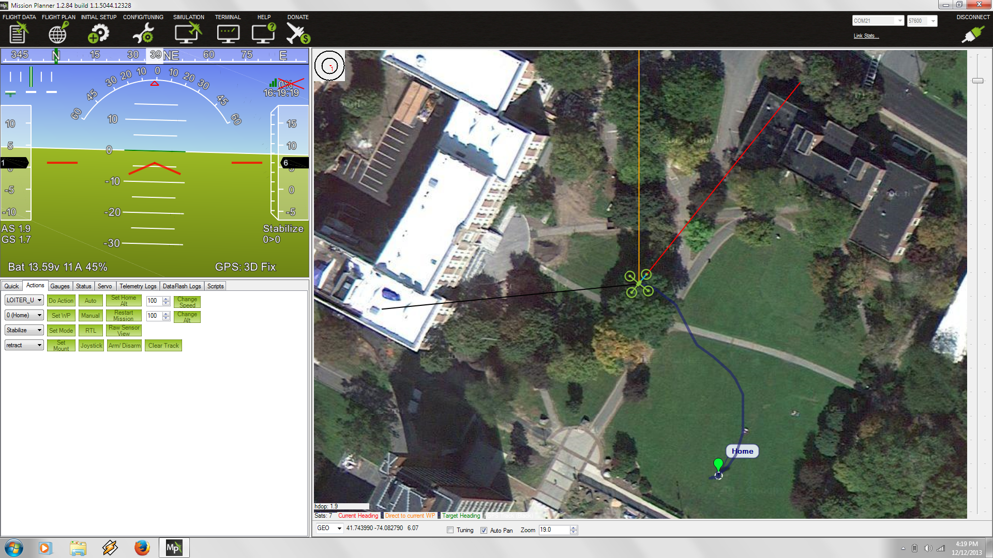

Slide 19
Results
The Copter was able to fly and follow the different GPS points given to it.
The Camera system is able to give a moderate not high quality stream to from the camera to the ground station.

Slide 20
Future Results
For this project there are may different direction to be taken
1) using open CV to navigate and maneuver obstacles
2) poling sensors that will be able to provide information about the environment around it .
3) Using IR and 3D modeling to create images of unknown environment's
4) Senior Design
5) possibly deliver some pizzas.

Slide 21
Questions?

